Slide 1
Program 6(Binary Search - Path Testing) /* Design, develop a code and run the program in any suitable language to implement the binary search algorithm. Determine the basis paths and using them derive different test cases execute these test cases and discuss the test results */

Slide 2
Agenda
Introduction
Cyclomatic complexity
Basic path testing approach
Conclusion

Slide 3
Introduction
A white box method
Proposed by McCabe in 1980’s
A hybrid of path testing and branch testing methods.
Based on Cyclomatic complexity and uses control flow to establish the path coverage criteria.

Slide 4
Cyclomatic Complexity
Developed by McCabe in 1976
Measures the number of linearly independent paths through a program.
The higher the number the more complex the code.

Slide 5
Basic path testing approach
Step 1: Draw a control flow graph.
Step 2: Determine Cyclomatic complexity.
Step 3: Find a basis set of paths.
Step 4: Generate test cases for each path.

Slide 6

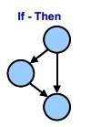
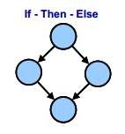

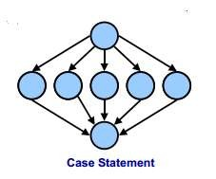
Draw a control flow graph
Basic control flow graph structures:

Slide 7
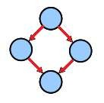
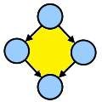
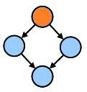
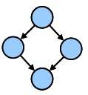
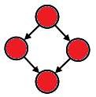
Draw a control flow graph
Arrows or edges represent flows of control.
Circles or nodes represent actions.
Areas bounded by edges and nodes are called regions.
A predicate node is a node containing a condition.

Slide 8
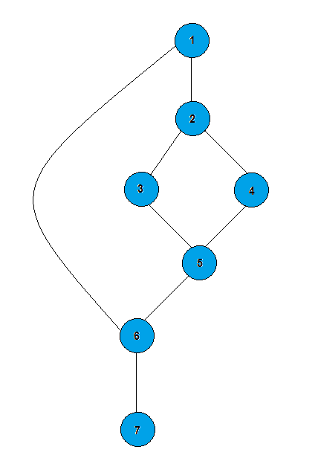
Draw a control flow graph
1: IF A = 100
2: THEN IF B > C
3: THEN A = B
4: ELSE A= C
5: ENDIF
6: ENDIF
7: Print A

Slide 9
Determine Cyclomatic complexity
There are several methods:
1Cyclomatic complexity = edges - node's+ 2p

Slide 10
Determine Cyclomatic complexity
Cyclomatic complexity = edges - nodes + 2p
p = number of unconnected parts of the graph.
Cyclomatic complexity = 8-7+ 2*1= 3.

Slide 11
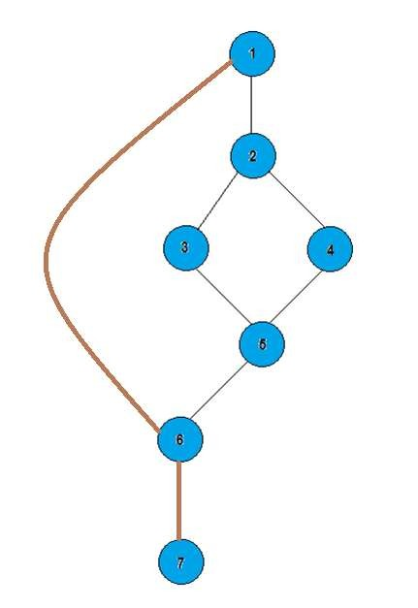
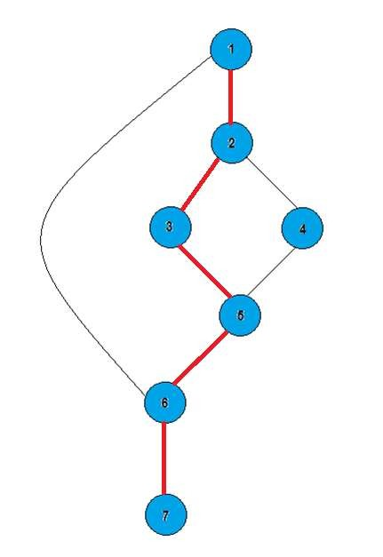
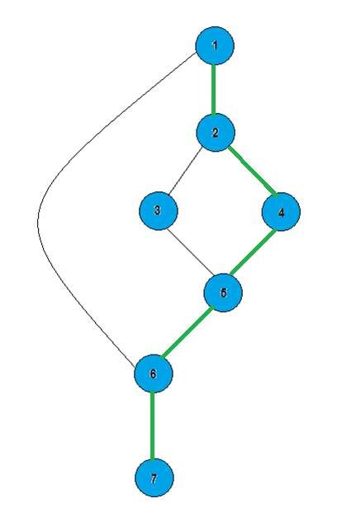
Find a basis set of paths
Path 1: 1, 2, 3, 5, 6, 7.
Path 2: 1, 2, 4, 5, 6, 7.
Path 3: 1, 6, 7.

Slide 12
Generate test cases for each path
We have 3 paths so we need at least one test case to cover each path.
Write test case for these paths .

Slide 13
#include<stdio.h> int binsrc(int x[],int low, int high, int key) { int mid; while(low<=high) { mid=(low+high)/2; if(x[mid]==key) return mid; if(x[mid]<key) low=mid+1; else high=mid-1; } return -1; }

Slide 14
int main() { int a[20],key,i,n,succ; printf("Enter the n value"); scanf("%d",&n); if(n>0) { printf("enter the elements in ascending order\n"); for(i=0;i<n;i++) scanf("%d",&a[i]); printf("enter the key element to be searched\n"); scanf("%d",&key); succ=binsrc(a,0,n-1,key); if(succ>=0) printf("Element found in position = %d\n",succ+1); else printf("Element not found \n"); } Else printf("Number of element should be greater than zero\n"); return 0; }

Slide 15
Binary Search function with line number
int binsrc(int x[],int low, int high, int key)
{
int mid; 1
while(low<=high) 2
{
mid=(low+high)/2; if(x[mid]==key) 3
return mid; 4
if(x[mid]<key) 5
low=mid+1; 6
else
high=mid-1; 7
} 8
return -1; 9
} 10

Slide 16
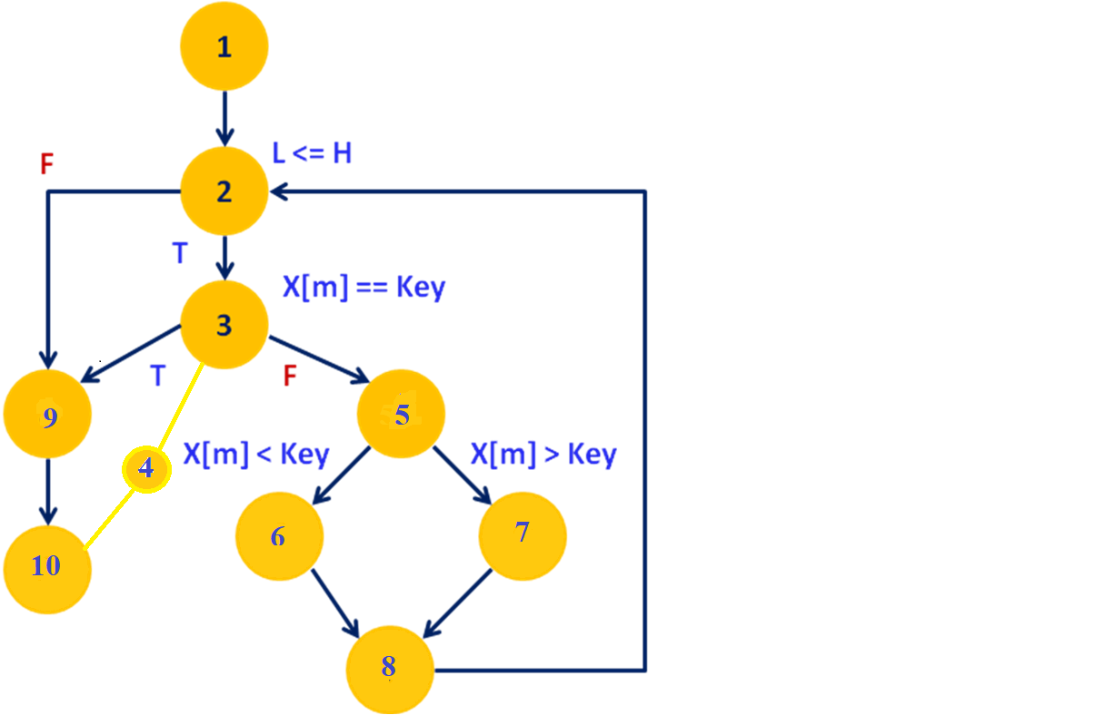
Program Graph

Slide 17
Test cases
1.Cyclomatic complexity=Edges-nodes+2(P)
12-10+2(1)=4 Test cases
2.Independent paths=
1.1-2-9-10------->(10,20,30,40,50) Empty list
2.1-2-3-4-10------(10,20,30,40,50) Success
3.1-2-3-5-6-8 -----(10,20,30,40,50) Success
4.1-2-3-5-7-8 -----(10,20,30,40,50) Success

